Slide 1
FRANCISCAN University –
SOFTWARE ENGINEERING
SFE 112
Professor Wessel
Topic 4 – Software Design

Slide 2

FRANCISCAN University Software Design - Today’s talk
Deriving a Solution
which satisfies
Software Requirements

Slide 3
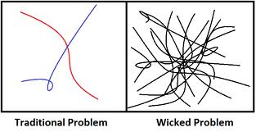
FRANCISCAN University Software Design – The ‘Wicked’ Problem
There is no definite formulation
There is no stopping rule
Solutions are not simply true or false
Every wicked problem is a symptom of another problem

Slide 4
FRANCISCAN University Software Design - Principles
Detailed Software Design – For each Architecture Element
Decompose system into modules
Ensure 100% coverage of requirements and 100% traceability to the architecture
Select & Evaluate Algorithms and Data Structures to be Implemented
Evaluate possible solutions and choose the most appropriate
Verify Implementation against the Requirements Specification
Use graphical, formal or other descriptive notations to describe the components of the design.
Baseline the Detailed Design (version control)

Slide 5

FRANCISCAN University Software Design – Major Categories
Component design: Decompose sub-systems into components.
Algorithm design: Design
algorithms for problem functions
Data structure design: Design data structures to hold problem data.
Interface design: Describe sub-system interfaces, internal and external

Slide 6

FRANCISCAN University Software Design – OPEN APPROACH
Open Systems Approach: An integrated business and technical strategy that employs a modular design and, where appropriate, defines key interfaces using widely supported, consensus-based standards that are published and maintained by a recognized industry standards organization – DOD Open Systems Joint Task Force
Open Systems: A Systems approach the implements sufficient open specifications for interfaces, services, and supporting formats to enable properly engineered applications software: (a) to be ported with minimal changes across a wide variety of systems, (b) to interoperate with other applications on local and remote systems and (c) to interact with users in a style that facilitates portability – IEEE POSIX Standard
Dictionary.COM

Slide 7
FRANCISCAN University Software Design – OPEN APPROACH
Open Systems Architecture:
Vendor-independent, non-proprietary, computer system or device design based on official and/or popular standards. It allows all vendors (in competition with one another) to create add-on products that increase a system's (or device's) flexibility, functionality, interoperability, potential use, and useful life. And enables the users to customize and extend a system's (or device's) capabilities to suit individual requirements. Also called open architecture.
- Business Dictionary.COM

Slide 8

FRANCISCAN University Software Design – MODULARITY
Modularity principle of keeping separate the various unrelated aspects of a system
also called separation of concerns
In principle, each module has a single purpose and will be relatively independent of the others
Benefits -
each module will be easy to understand & develop
easier to locate problems
easier to change/update the system
Two ways (not the only way) to determine modularity: Coupling and Cohesion

Slide 9
FRANCISCAN University Software Design – Coupling
Uncoupled modules have no direct interconnections at all
Loosely coupled modules have some dependence, but their interconnections are weak
Tightly coupled a great deal of dependence on each other
Uncoupled -
no dependencies
Loosely coupled -
some dependencies
Tightly coupled -
many dependencies

Slide 10

FRANCISCAN University Software Design – Coupling
Degrees of Coupling (a spectrum)
The amount of control that one module has over the other (may be direct or indirect)
For Example:
The references made from one module to another
The amount of data passed from one module to another

Slide 11
FRANCISCAN University Software Design – Coupling Types
Content coupling
Common coupling
Control coupling
Stamp coupling
Data coupling
Content coupling
Common coupling
Control coupling
Stamp coupling
Data coupling
Uncoupled
TIGHT COUPLING
LOOSE COUPLING
LOW COUPLING

Slide 12
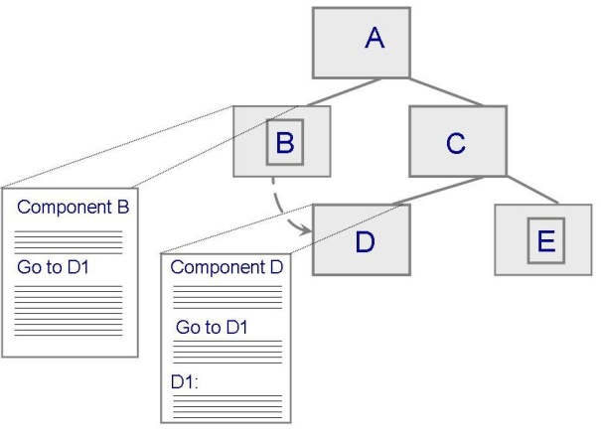
FRANCISCAN University Software Design – Coupling Types
Content Coupling
One component modifies an internal data item in another or alters its data state in another way.
Module B
_________________
_________________
_________________
_________________
Generate D
Call D
_________________
_________________
_________________
_________________
_________________
_________________
_________________
_________________
Module D
_________________
_________________
_________________
_________________
_________________
_________________
_________________
_________________
_________________
_________________

Slide 13
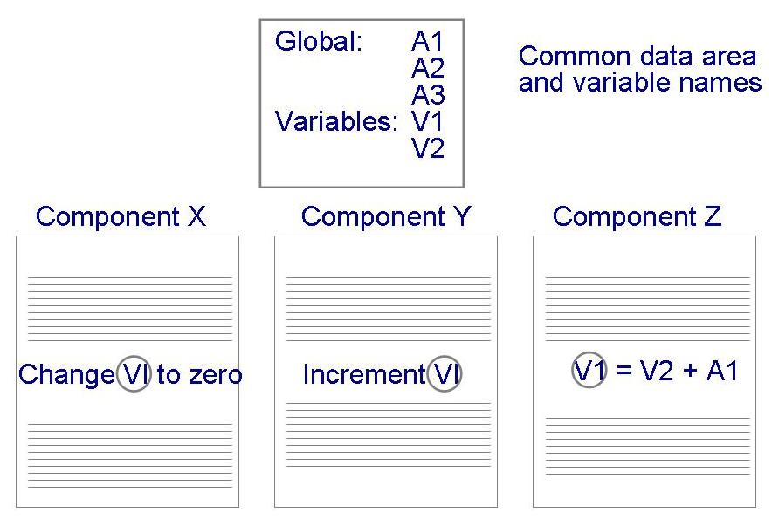
FRANCISCAN University Software Design – Coupling Types
Common Coupling
A change to common data – ripple effect

Slide 14
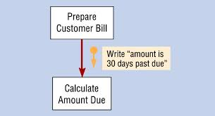
FRANCISCAN University Software Design – Coupling Types
Control Coupling
When one module passes/returns parameters to control the behavior of another module
It may be impossible for the controlled module to function without some direction from the controlling module

Slide 15
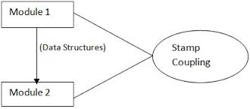
FRANCISCAN University Software Design – Coupling Types
Stamp & Data Coupling
Stamp : when complex data structures are passed between modules
represents a more complex
interface between modules,
Data : when data values, and not structured data, are passed
simpler and less likely to be affected by changes in data representation

Slide 16
FRANCISCAN University Software Design – Cohesion
Cohesion : the dependence within and among a module’s internal elements (e.g., data, functions, internal modules)
Coincidental
Logical
Temporal
Procedural
Communicational
Functional
Informational
LOW COHESION
HIGH COHESION

Slide 17

FRANCISCAN University Software Design – Cohesion
Coincidental (worst degree)
Parts are unrelated to one another
Logical
Parts are related only by the logic
structure of code
Temporal
Module’s data and functions related because they are used at the same time in an execution
Procedural
Similar to temporal, and functions pertain to some related action or purpose

Slide 18

FRANCISCAN University Software Design – Cohesion
Communication
Operates on the same data set
Functional (ideal degree)
All elements essential to a single function are contained in one module, and all of the elements are essential to the performance of the function
Informational
Adaption of functional cohesion to data abstraction and object-based design

Slide 19
FRANCISCAN University Software Design – Interfaces
An Interface
Opens/advertises what services the software unit provides
defines what the unit requires, in terms of services or assumptions, for it to execute
Module
Data
________________
_________________
_________________
Operation 1
_________________
_________________
_________________
_________________
Operation 2
_________________
_________________
_________________
_________________
Interface A
Operation 1 ()
Operation 2 ()
Operation 4 ()
Operation 3
_________________
_________________
_________________
_________________
Operation 4
_________________
_________________
_________________
_________________
Interface B
Operation 2 ()
Operation 3 ()

Slide 20
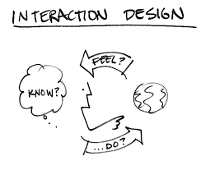
FRANCISCAN University Software Design – Interfaces
Interface specification
Should communicate others everything needed to use our software unit correctly
Purpose
Preconditions (assumptions)
Protocols
Post-conditions (visible effects)
Quality attributes

Slide 21

FRANCISCAN University Software Design – Information Hiding
Information hiding is a form of system decomposition
An architecture decision
Each software unit encapsulates a
separate design decision that could be
changed in the future
A Way to Implement Cohesion and Coupling
Modules that hides a data representation may be informationally cohesive
A module that hides an algorithm may be
functionally cohesive
Advantage (of Information Hiding) is loose coupled

Slide 22
FRANCISCAN University Software Design – TIPS
Use the information about a software modules dependencies to devise an incremental schedule of Development & Test
Map out the units’ use relationships
Relates each software unit to the other software units on which it depends
Uses graphs can help to identify progressively larger subsets of our system that we can implement and test incrementally

Slide 23
FRANCISCAN University Software Design – TIPS
Functional decomposition
Separate distinct logical functions in a system.
Examples of such functions:
“Display menu”
“Get user option”

Slide 24
FRANCISCAN University Software Design – Modular Design Criteria
Always self evaluate your modular design to convince yourself you are on the right track, and prove to other interested parties (boss, customer, user…)
Modular Decomposability
supports the decomposition of a problem into smaller sub-problems, which can be solved independently
Note: large systems design is never truly top-down.
Example

Slide 25
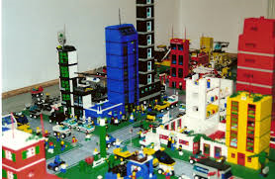
FRANCISCAN University Software Design – Modular Design Criteria
Modular Composability
Production of modules that may be freely combined to produce new systems. – Think Legos!
Composability is directly related to the issue of reusability
often at odds with decomposability; top-down design,

Slide 26

FRANCISCAN University Software Design – Modular Design Criteria
Modular Understandability
Can the component be understood
on its own?
Are meaningful names used?
Is the design well-documented?
Are complex algorithms used?
For Instance:
Take a thousand lines program, containing no procedures; it’s just a long list of sequential statements. Divide it into twenty blocks, each fifty statements long; make each block a method.
THIS CAN BE VERY COSTLY, AND BECOME THE DEMISE OF A SYSTEM

Slide 27
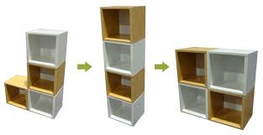
FRANCISCAN University Software Design – Modular Design Criteria
Modular Continuity
A small change in the problem specification leads to a change in just one (or a small number of ) modules.
Modular Protection
The effect of an abnormal
condition at run-time only effects
one (or very few) modules
Errors do not propagate or ripple
Modular Reusability
Like Composability, perhaps a more generic use

Slide 28
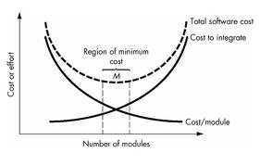
FRANCISCAN University Software Design – TIPS
Modularity & Cost
Avoid Too Little, or Too Many Modules
An Art to find
the Sweat spot
of just the
right amount

Slide 29
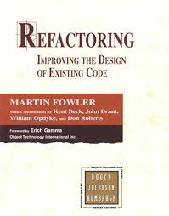
FRANCISCAN University Software Design – TIPS
Refactoring – It happens…
“The process of changing a software system
in such a way that it does not alter the
external behavior of the code [design] yet improves its internal structure.” Fowler
When software is refactored, the design is examined for
redundancy
unused design elements
inefficient or unnecessary algorithms
poorly constructed or inappropriate data structures
or any other design failure that can be corrected to yield
a better design.

Slide 30

FRANCISCAN University Software Design – TIPS
REDUCE COMPLEXITY!
measure certain aspects of the software
lines of code, # of if-statements, depth of nesting,…
use these numbers as a criterion to assess a design, or to guide the design
interpretation: higher value ⇒ higher complexity ⇒ more effort required (= worse design)
two kinds:
intra-modular: inside one module
inter-modular: between modules

Slide 31
FRANCISCAN University Software Design – TIPS
1
CYCLOMATIC COMPLEXITY
e = number of edges (13) [# ARROWS]
n = number of nodes (11)
p = number of connected components (1)
CV = e - n + p + 1 = 4
2
3
4
5
6
11
7
8
9
10

Slide 32

FRANCISCAN University Software Design – TIPS
Object Oriented Complexity Factors
WMC: Weighted Methods per Class –
measure for size of class
DIT: Depth of Inheritance Tree
distance of class to root of its inheritance tree
NOC: Number Of Children
counts immediate descendants
CBO: Coupling Between Object Classes
count of all classes a given class is coupled with

Slide 33

FRANCISCAN University Software Design – TIPS
LCOM: Lack of COhesion of a Method
cohesion = glue that keeps the module (class) together
if all methods use the same set of state variables: OK, & that is the glue
if some methods use a subset of the state variables, and others use another subset, the class lacks cohesion
LCOM = number of disjoint sets of methods in a class
two methods in the same set share at least one state variable

Slide 34
FRANCISCAN University Software Design – Sample Methods
Design Patterns
Provides solution to a recurring problem
Verified / Validated in many circumstances
Documents well-prove design experience
Abstraction above the level of a single component
Provides common vocabulary and understanding
Are a means of documentation
Supports construction of software with defined properties

Slide 35
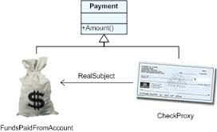
FRANCISCAN University Software Design – Sample Methods
Design Pattern - Proxy
Context:
Client needs services from
other component, direct access
may not be the best approach
Problem:
We do not want hard-code access
Solution:
Communication via a representative, the Proxy

Slide 36
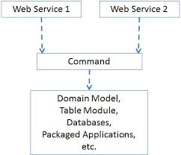
FRANCISCAN University Software Design – Sample Methods
Design Pattern – Command Process
Context:
User interface that must be flexible or provides functionality beyond handling of user functions
Problem:
Well-structured solution for mapping interface to internal functionality. All ‘extras’ are separate from the interface
Solution:
A separate component, the Command Processor, takes care of all commands Actual execution of the command is delegated

Slide 37
FRANCISCAN University Software Design – Sample Methods
Anti-Patterns: To be Avoided!
God class: class that holds most responsibilities
(its not easy being God….)
Lava flow: dead code
Poltergeist: class with few responsibilities and a short life
Golden Hammer: solution that does not fit the problem
Stovepipe: (almost) identical solutions at different places
Swiss Army Knife: excessively complex class interface
TOAD Code??

Slide 38
FRANCISCAN University Software Design – Summary
Essence of the design process: decompose system into parts / Modularity
Desirable properties of a decomposition: coupling/cohesion, information hiding, (layers of) abstraction
There have been many attempts to express these properties in numbers / metrics, track!
Keep it simple as possible!
Notes:
Object oriented design is the topic of a chapter on its own.

